Slide 1

DEPARTMENT OF COMPUTER SCIENCE ENGINEERING
TECHNICAL SEMINAR ON
E-skin
Under the Guidance of :
Mrs. Soniya Komal V
Asst. Professor
👩
Presented by,
Nayana S (1RG17CS068)

Slide 2
Contents
ABSTRACT
INTRODUCTION
E-SKIN Features
STRUCTURE OF E-SKIN
FABRICATION OF E-SKIN
ADVANTAGES AND DISADVANTAGES
APPLICATION
FUTURE SCOPE
CONCLUSION
REFERENCE

Slide 3
Abstract
Electronics plays important role in developing simple devices used for any purpose.
It is ultrathin electronics device attaches to the skin like a sick on tattoo which can measure electrical activity of heart, brain waves & other vital signals.
Used as skin replacement for people who suffered skin trauma.
Consists of millions of embedded electronics measuring devices.
Wirelessly monitor the vitals movements of patient

Slide 4
Introduction
.
E-skin is a material which mimics the Human Skin in one or more ways.
Goal is to develop sensors flexible substrates that are compliant to curved surface.
Main objective of artificial skin is to tactile sense.
Capable of skin-like texture, wetting , sweat pore density, and sweat rates.

Slide 5
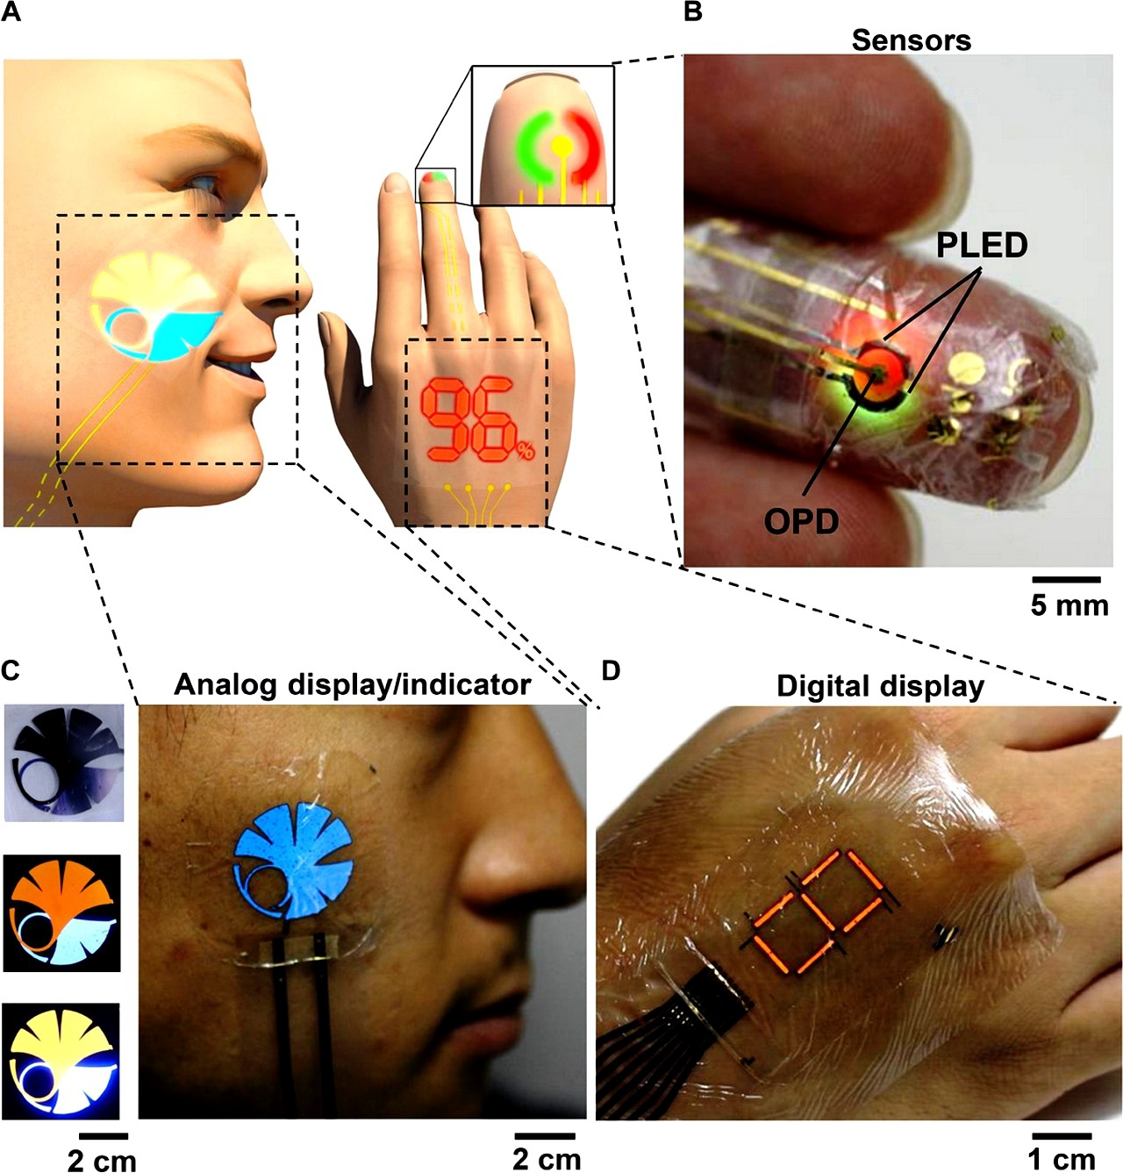
Features
Measure electrical activity of the heart ,brainwaves & other vital signs.
Can record electrical activity along the scalp.
Muscle contractions in the hand can control the mouse in a computer game.

Slide 6
Succinctly highlight some of these challenges
Intrinsically stretchable and self-healing materials.
Tactile, chemical, and electrophysiological sensors.
Large-area fabrication and integration techniques.
Wireless communication and signal processing technologies.
Electrodes for neural interfaces.

Slide 7
Structure
Wireless Communication and signal processing technology.
Material mimicking human skin.
Fabrication and Integration.
Tactile, chemical and electrophysiological sensors.

Slide 8
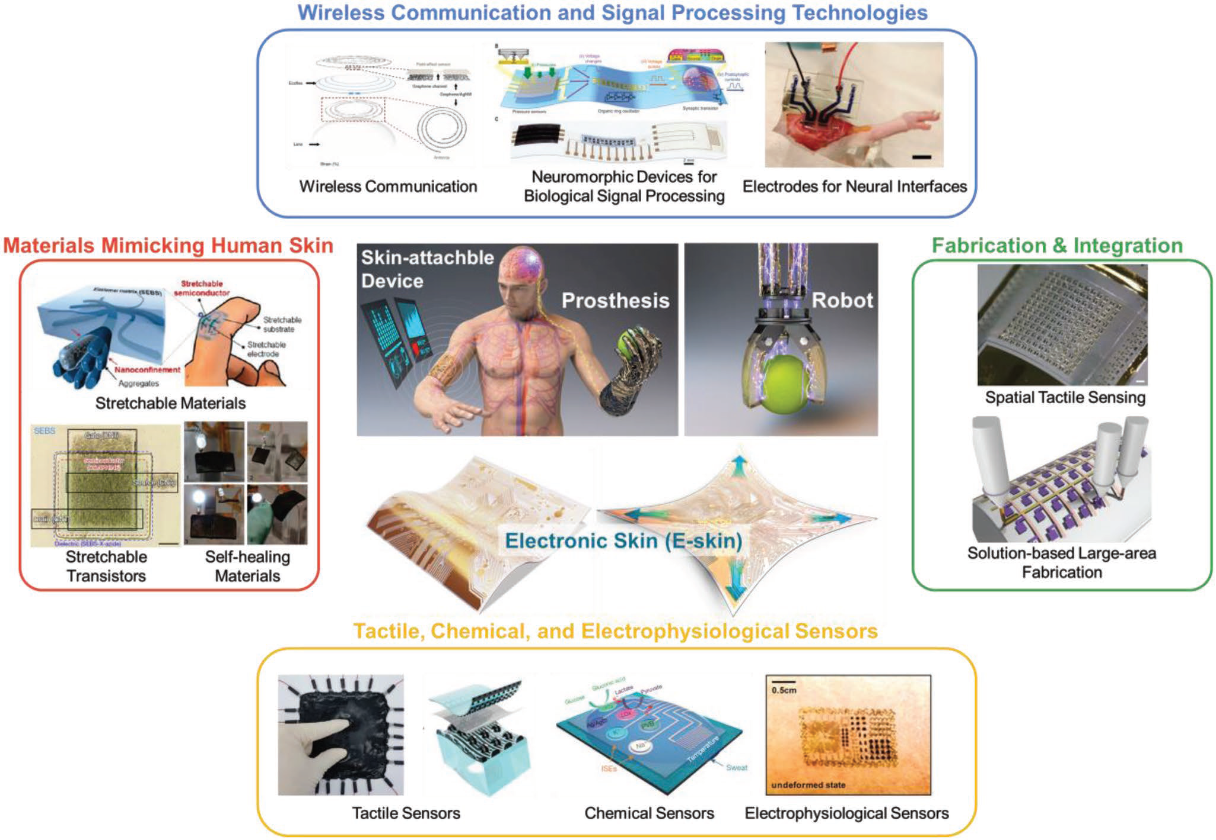

Slide 9
Types of Sensors in E-skin
Temperature Sensor.
Slip and Force Vector Sensor.
Multifunctional Sensor and Decoupling Technology.
Chemical Sensor.
Electrophysiological Sensor.

Slide 10
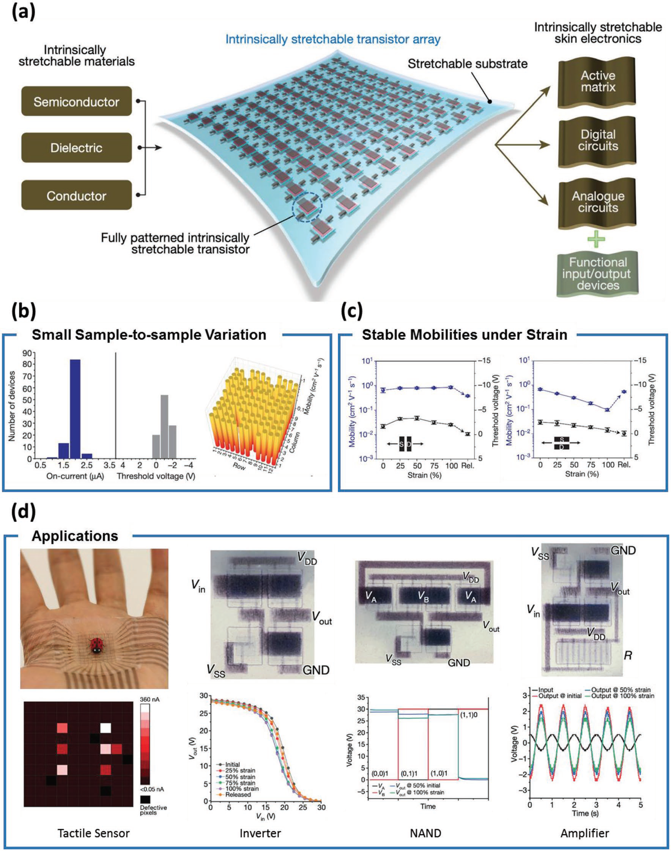
Fabrication

Slide 11
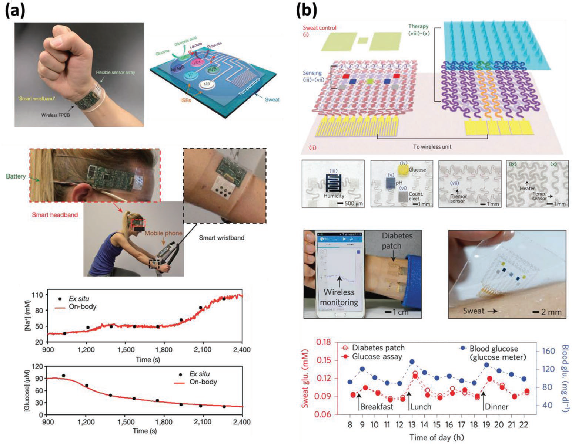

Slide 12
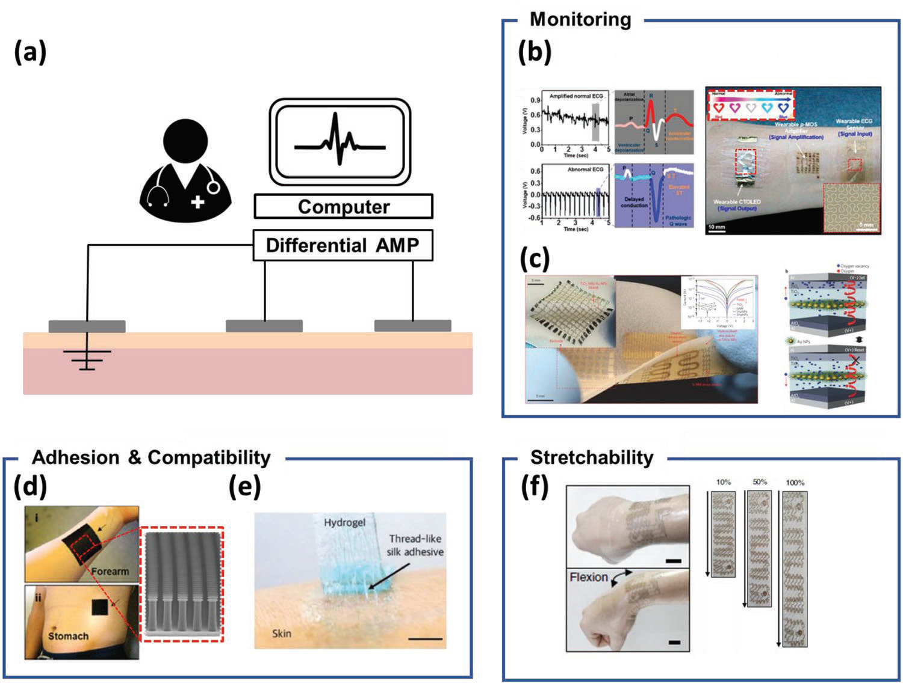

Slide 13
Advantage
Compact in size.
Attachment and detachment is easy.
More flexible.
Light in weight.
It replaces present system of ECG and EEG.
Twistable & stretchable.
Easy to handle.

Slide 14
Disadvantage
Cost is high.
Single use.
Portable power and long-term durability issues.

Slide 15
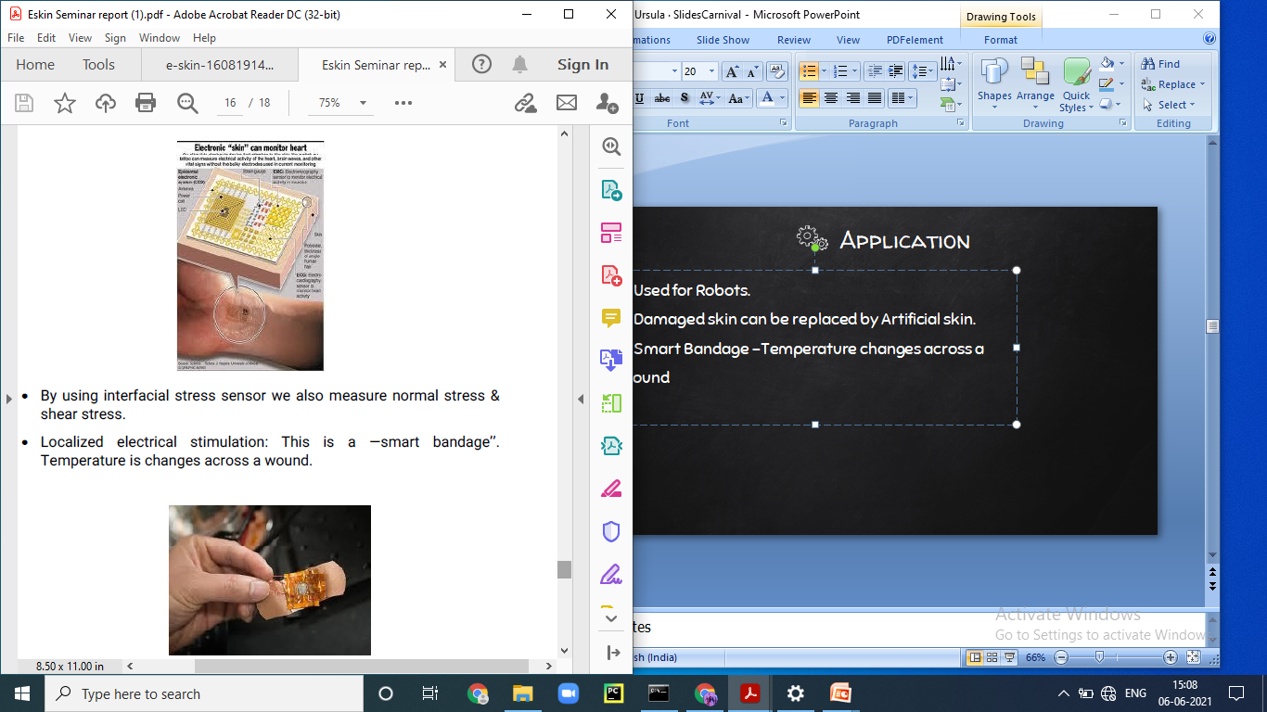
Application
Skin attachable devices, robotics, and prosthetics.
Enable continuous health monitoring and point-of-care diagnostics to improve people’s health.
Smart Bandage –Temperature changes across a wound.
Materials with intrinsic stretch ability and self-healing
ability

Slide 16
Comparison
Old
OLED and AMOLED are used.
Less Features .
Less Efficiency and compatible.
New
Sensors to every tactile.
More Features.
More efficiency and compatible.

Slide 17
Future Scope
Bendable sensors and display.
Predicting a patient of an oncoming heart attack hours in advance.
Placing vital screens for knowing our body function.
Use in car dashboard, interactive wallpaper.

Slide 18
Conclusion
Devices are compact in size and best at functioning.
Scientists create artificial skin that emulates human touch.
Smarter and similar to human skin.
Offers greater Sensitivity and bendable sensors.

Slide 19
Reference
https://en.wikipedia.org/wiki/Electronic_skin
https://www.livemint.com/technology/tech-news/study-suggests-electronic-skin-has-strong-future-ahead-11606552695779.html
https://www.nature.com/articles/528026
https://www.oled-info.com/oled-introduction
https://onlinelibrary.wiley.com/doi/full/10.1002/adma.201904765

Slide 20
thanks!
Any questions?

